Slide 1
COMP-1597:Digital Media Production
Group 6 – Sharna Patten-Walker, Aaron Watts-Corfe, Dominic McNeil, Jacob Groves

Slide 2
Introduction – Bike Rental Service-Simulator
Concept
The digital artefact is an advertisement for a bike rental service around a park setting. Around the park environment there will be posters that are advertising the bike rental service. The player explores the park and collects the posters. After a set amount of posters is collected, the player wins and is taken to the website for the bike rental service or a point in the game that represents the bike rental service with all the information.
Purpose
The general purpose of picking a bike rental service for the intended artefact is targeting various audiences for example; elderly might use the park for walking and be interest in interacting with these rental bikes due to them being restricted in movement and wanting to discover various areas. Not only would the elderly be interested but youth and families could also be interested as they would want to discover new experiences and maintain a healthy and proactive lifestyle.
The enjoyment of riding a bike is the main reason why bike rental maybe of large appeal due to the observation and having the chance to see a lot more than the user would, if they were to run or walk. Observation is not the main intention of walking the main purpose is to get from one area to the next, not observing the environment as much.
Riding a bike stationary as some do for fitness, like services such as (SoulCycle, 2006) isn’t as interesting because the user isn’t actually travelling or going anyway. The bike simulator however, allows you to be an immersive environment, rather than just staring at a wall in a room. This is the main reasoning for the artefact not being a fitness tool.

Slide 3
Group Members/Roles
Aaron Watts-Corfe - Programmer
Sharna Patten-Walker - Designer
Dominic McNeil - Artist
Jacob Groves - Designer

Slide 4
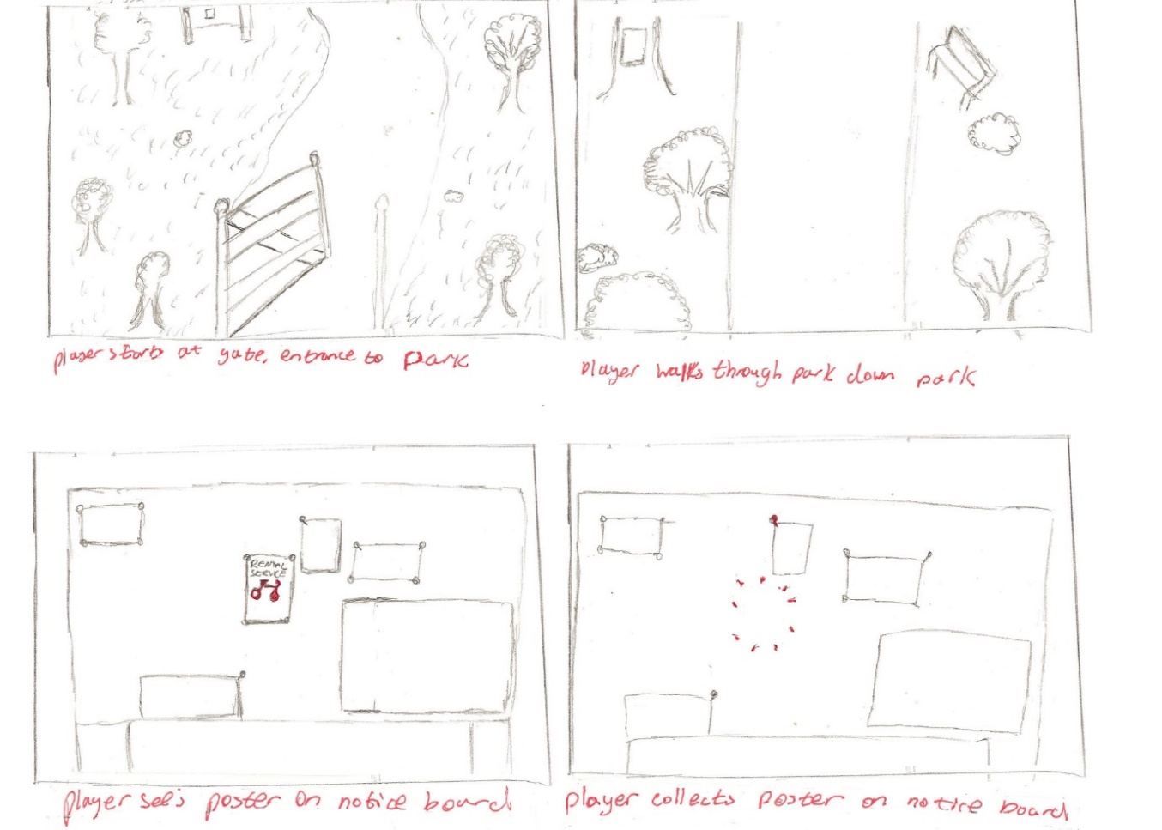
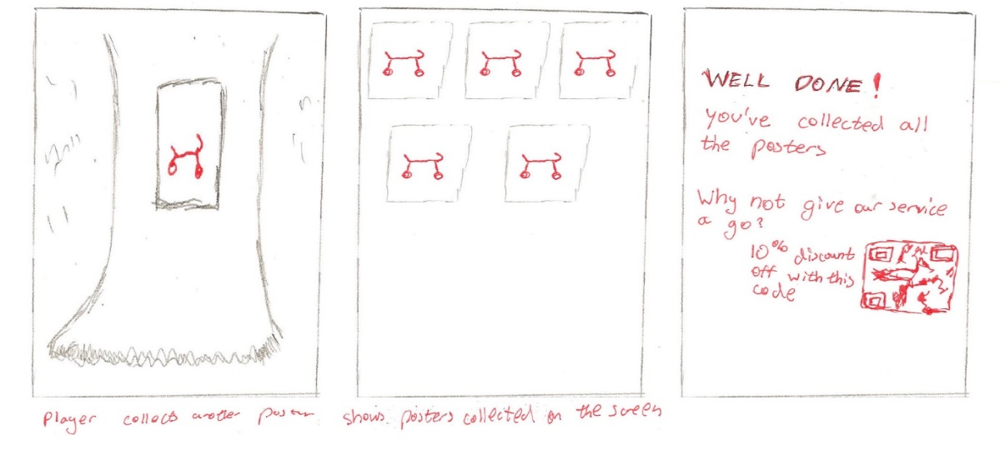
Pre- Production - Storyboard
1.
2.
5.
6.
7.
3.
4.

Slide 5
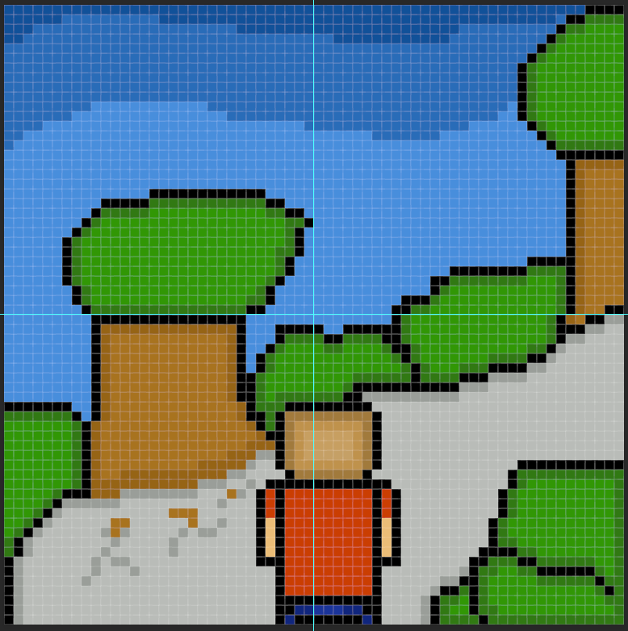
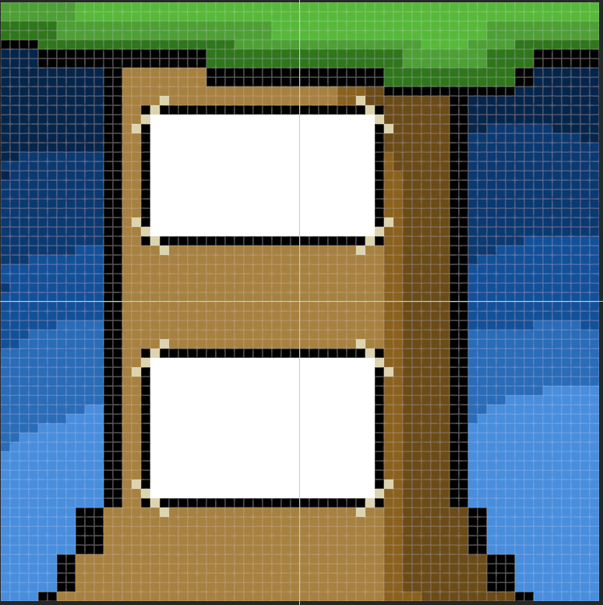

Pre-Production - Designs

Slide 6
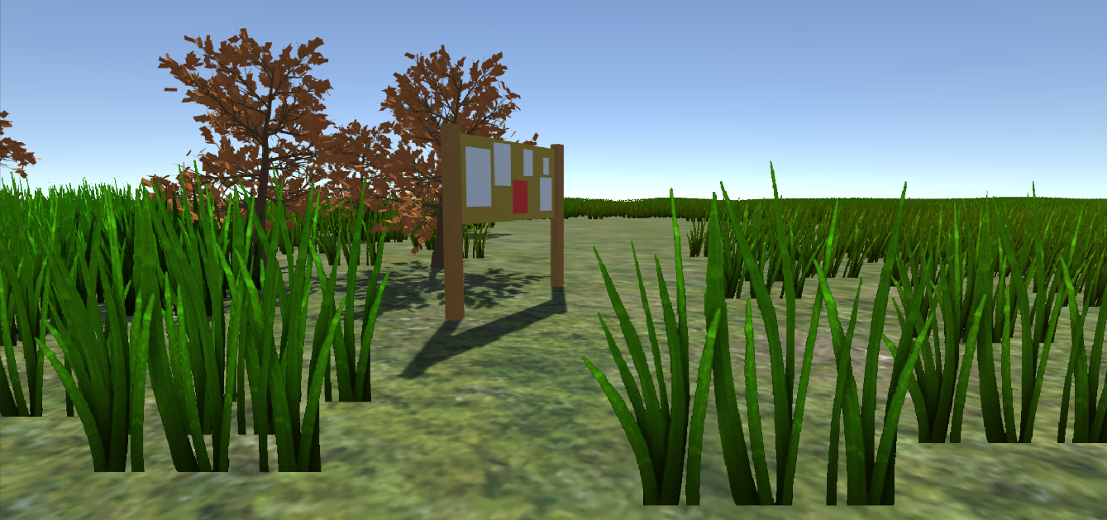
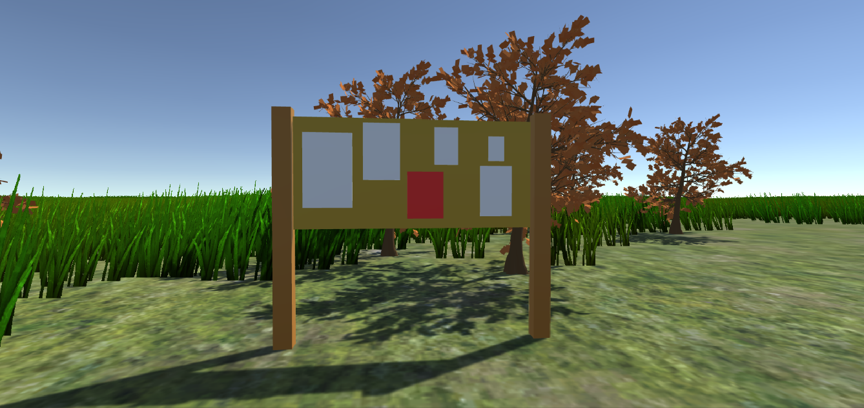
Pre-Production - Prototype

Slide 7
Pre-Production - Requirements
Requirement assessed: The objective of the game should be clear
Requirement assessed: Player should be able to look and move around and interact with environment
Requirement assessed: There should be feedback for the user when interacting with the game
Requirement assessed: Player should be able to pick up/collect posters
Requirement assessed: Players should be able to see/know how many posters they have collected.
Requirement assessed: The game should be evenly paced so the player doesn’t get bored/speed through it.
Requirement assessed: Game should respond once the player has collected every poster
Requirement assessed: The player should be able to begin the game from the main menu. Interact with the main menu and navigate through the options.
Requirement assessed: The game should be visually pleasing
Requirement assessed: The player should be able to quit the game from the main menu.

Slide 8
Production
Development
- Level Design/Modelling
- Lights/Lamp Lights
- UI
- Core Mechanics
Demo Time

Slide 9
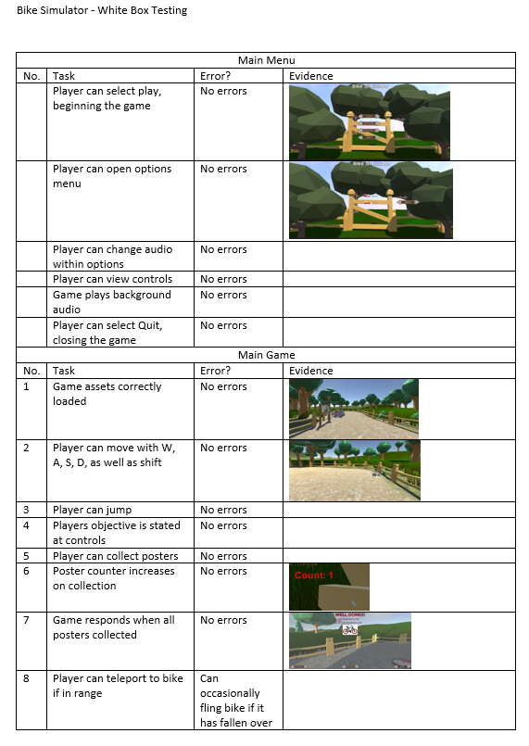
Post Production
White Box-Testing

Slide 10
Improvements
Improvements that could have been made to the Digital Artefact.
- Refine controls/gameplay,
- Try fix minor bugs,
- Implement AI, and finally
- More bikes.

Slide 11
Any Questions?

